Slide 1
Applied Physics Credit Hours: 3 Instructor: Maiza Zanib

Slide 2

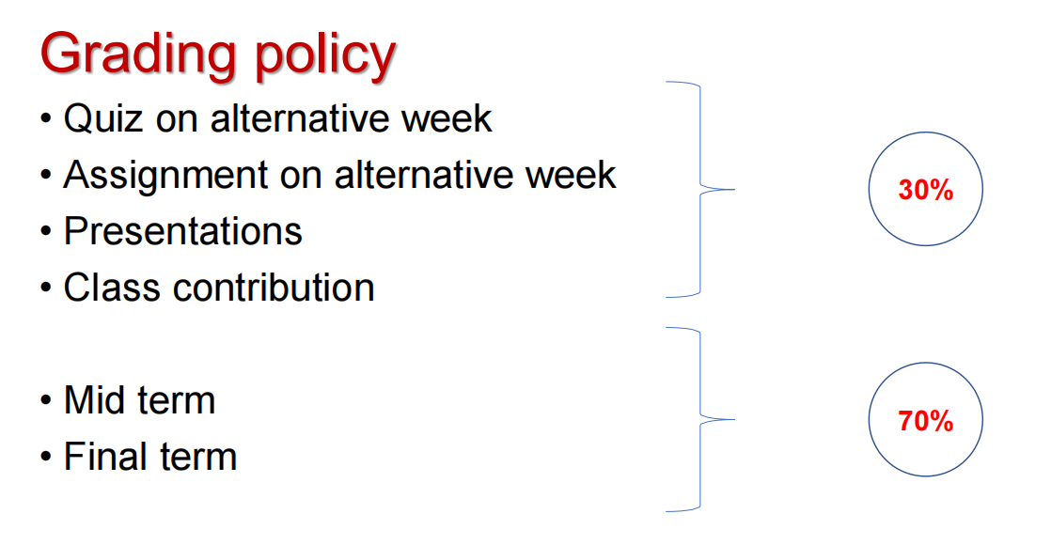

Slide 3
Course ouline
Electric force and its applications and related problems , conservation of charge, charge
quantization,Electricfieldsduetopointchargeandlinesofforce.Ringofcharge,Diskof
charge,A point chargein an electric field,Dipole in a n electric field, The flux of vectorfield,
Thefluxofelectricfield,Gauss’Law,ApplicationofGauss’Law,Sphericallysymmetriccharge
distribution, A charge isolated conductor, Electric potential energy, Electric potentials,
Calculating the potential from the field and related problem Potential due to point and
continuous charge distribution, Potential due to dipole, equipotential surfaces, Calculating the
field from the potential , Electric current, Current density, Resistance, Resistivity and
conductivityOhm’s lawanditsapplications,TheHalleffect,Themagnetic forceona current,
The Biot- Savart law, Line of B, Two parallel conductors, Amperes’ Law, Solenoid, Toroids,
Faraday’s experiments, Faraday’s Law of Induction, Lenz’s law, Motional emf, Induced electric
field, Induced electric fields, The basic equation of electromagnetism, Induced Magnetic field,
Thedisplacement current,ReflectionandRefractionoflightwaves,Totalinternalreflection,
Two source interference, Double Slitinterference,related problems,Interference from thin
films, Diffraction and the wave theory, related problems, Single-Slit Diffraction, related
problems,Polarizationof electromagneticwaves,Polarizing sheets,relatedproblems.

Slide 4
Text Books:
• “Physics for Scientists Engineers Modern Physics 9th Ed
Serway Jewett”.
Reference Books:
• Fundamentals of Physics (Extended), 10th edition, Resnick and
Walker
• Narciso Garcia, Arthur Damask, Steven Schwarz., “Physics for
Computer Science Students”, Springer Verlag, 1998

Slide 5
What is applied physics?
Applied physics is the application of physics to solve scientific or engineering problems. It is usually considered to be a bridge or a connection between physics and engineering.
Applied physicists use physics or conduct physics research to develop new technologies or solve engineering problems. For example, medical physicists in radiation therapy departments of hospitals measure and calculate the radiation doses given to cancer patients.

Slide 6
What is difference b/w physics and applied physics
Physics studies matter, force, and energy, as well as their interaction with the world. Applied physics is physics which is intended for a particular technological or practical use.

